Slide 1
Nano RISC ISA
8 bit integers
8 bit byte addressable memory
Direct addressing only
Two registers: R0, R1
7 instructions:
ld: R0 <- M[a]; R1 <- R0
st: M[a] <- R0
add: R0 <- R0 + R1
sub: R0 <- R0 - R1
incr: R0 <- R0 + 1
decr: R0 <- R0 - 1
bneg: pc <- a if negative
Instruction format:
7 6
5 0
bits
ld
00
a
st
01
a
alu
10
op
op:
000000 = add
000001 = sub
000010 = incr
000011 = decr
br
11
a

Slide 2
Nano RISC Execution
Harvard architecture (i.e. separate instruction/data memory)
Single cycle execution
Control signals based on instruction class
7 instructions but only 4 classes

Slide 3
Nano RISC Datapath
PC
Instr Mem
instr
imm
DECODE
R0
R1
in1
in2
out
ALU
add
incr
N
wr data
N
Data Mem
address
rd data

Slide 4
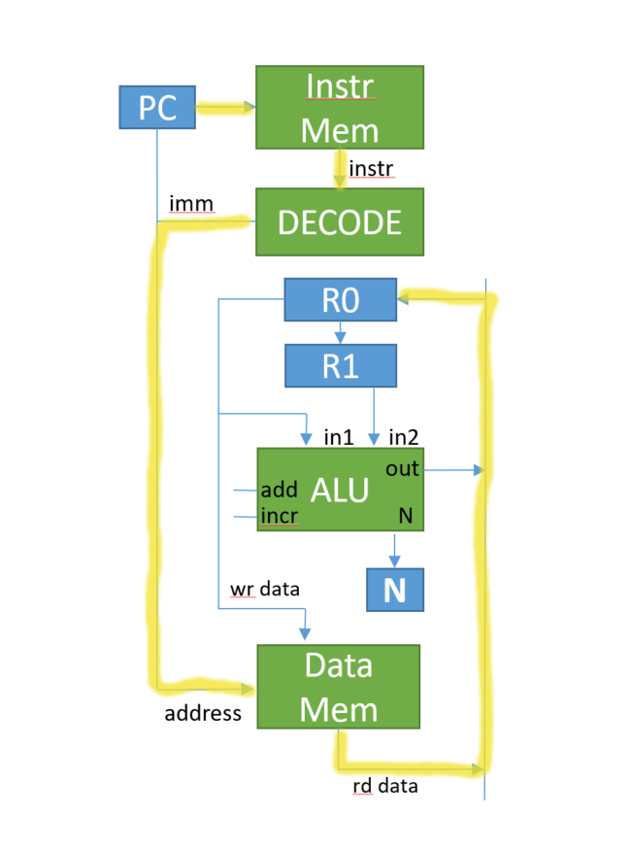
Load

Slide 5
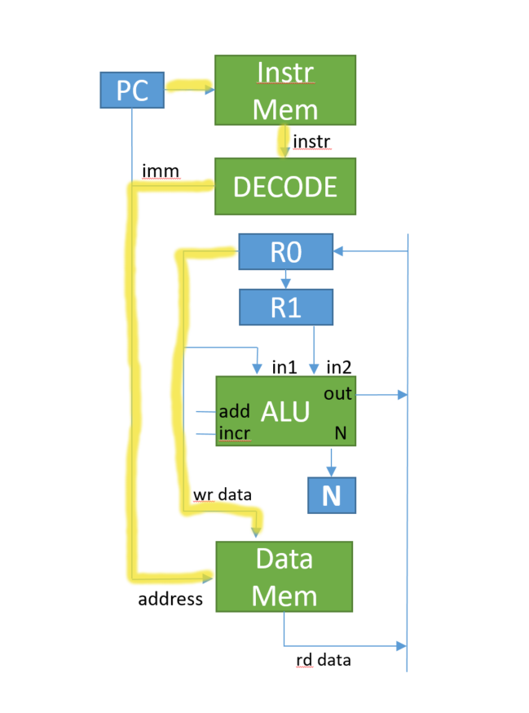
Store

Slide 6
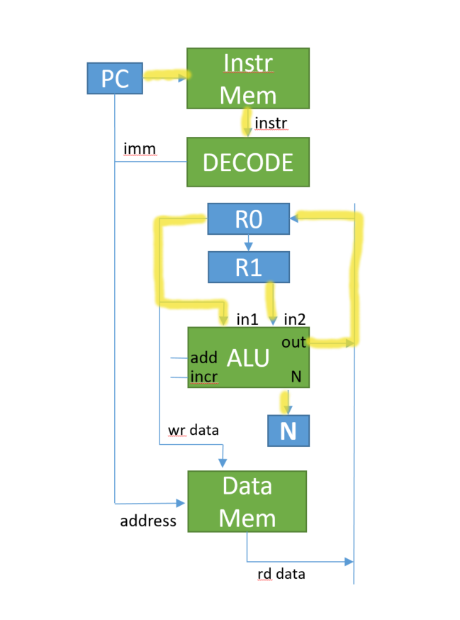
ALU

Slide 7
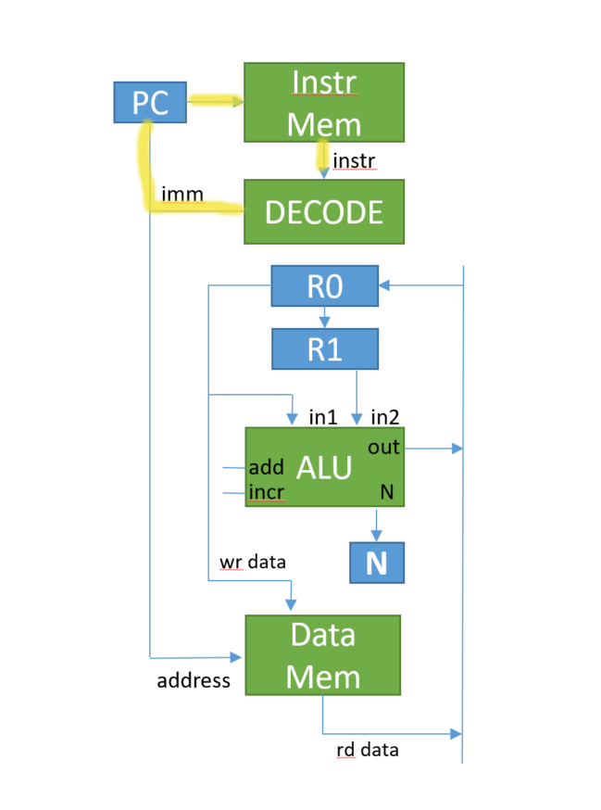
Branch

